Slide 1
Nuclear Structure and IBM Satendra Sharma Professor and Dean, Faculty of Science Yobe State University, Damaturu, Nigeria
Nuclear structure refers to the arrangement and behaviour of protons and neutrons (collectively known as nucleons) within the atomic nucleus. The study of nuclear structure is fundamental to understanding how atomic nuclei behave, their stability, and the interactions that govern nuclear reactions. The key factors influencing nuclear structure include:
1.Nucleon-Nucleon Interactions: Protons and neutrons interact through the nuclear force, which binds them together. These interactions are complex, involving both short-range attractive forces and long-range repulsive forces.

Slide 2
2. Shell Model: This is a simple, yet powerful, model for describing the structure of the nucleus. It treats protons and neutrons as moving in discrete energy levels or shells, much like electrons in atomic shells. The shell model helps explain the stability of certain isotopes and the properties of the nucleus, such as spin and parity. 3.Collective Model: This model describes the nucleus as a system that can exhibit collective behavior, like rotations and vibrations, due to the collective motion of nucleons. It accounts for phenomena such as nuclear deformation (spherical, prolate, or oblate shapes) and nuclear excitations. 4.Deformation and Shape: Nuclei may not be spherical; they can take on prolate (elongated) or oblate (flattened) shapes. This deformation is particularly important for heavier nuclei and can lead to unique phenomena such as nuclear rotations.

Slide 3
Nuclear Structure
Shell Model
Geometric Models
Interacting Boson Models

Slide 4
5. Pairing and Collective Excitations: In certain nuclei, pairs of protons or neutrons interact in a correlated way, leading to collective excitations. These correlations are a key feature in nuclear structure and can result in behaviors such as superfluidity and the formation of collective vibrational states. Interacting Boson Model (IBM): The IBM is a theoretical framework used to describe the collective aspects of nuclear structure, particularly the low-energy excitations in atomic nuclei. It was developed by F. Iachello and A. Arima in the 1970s. The IBM has become an essential tool for understanding collective motion, such as vibrations and rotations, in even-even nuclei (nuclei with an even number of protons and neutrons).

Slide 5
1.Key Concepts of the IBM: Boson Representation: The IBM treats nucleons (protons and neutrons) as collective excitations that can be represented by bosons. A boson is a particle that obeys Bose-Einstein statistics, and in the IBM, the nucleons are approximated as bosonic pairs. These pairs can be of two types: S-bosons: These represent pairing of nucleons in the s-state (orbital angular momentum L=0). D-bosons: These represent pairing of nucleons in the d-state (orbital angular momentum L=2).

Slide 6
2. Hamiltonian: The dynamics of the IBM are described by an effective Hamiltonian that includes terms representing the interactions between the bosons. These interactions can be modeled by terms such as: Boson-boson interaction: Describes the attractive forces between pairs of nucleons, leading to collective motion. Single-particle excitations: Models the transition between different collective states. 3. Symmetry Groups: The IBM uses group theoretical methods to classify nuclear states. The two main symmetries in the IBM are: U(6) Symmetry: This is the fundamental symmetry group of the IBM, describing the full space of bosonic configurations. SU(3) Symmetry: For certain nuclei, the IBM can reduce to SU(3) symmetry, which describes the rotational behavior of deformed nuclei. This symmetry is often associated with the rotation of a deformed, ellipsoidal shape of the nucleus.

Slide 7
4. Phases of Nuclear Collective Motion: The IBM describes various phases of nuclear collective motion: U(5) limit: This corresponds to spherical nuclei and represents a vibrational model where the nucleus undergoes collective vibrational excitations. SU(3) limit: This corresponds to prolate or oblate deformed nuclei and represents a rotational model where the nucleus undergoes collective rotational motion. O(6) limit: This corresponds to nuclei with soft shapes, where the transition between vibrational and rotational modes is more flexible.

Slide 8
Interacting boson approximation
Dominant interaction between nucleons has pairing character ⇒ two nucleons form a pair with angular momentum J=0 (S pair).
Next important interaction between nucleons with angular momentum J=2 (D pair).
Approximation: Replace S and D fermions pairs by s and d bosons. Argument:

Slide 9
Microscopy of IBM
In a boson mapping, fermion pairs are represented as bosons:
Mapping of operators (such as Hamiltonian) should take account of Pauli effects.
Two different methods by
requiring same commutation relations;
associating state vectors.
T. Otsuka et al., Nucl. Phys. A 309 (1978) 1

Slide 10
The interacting boson model
Describe the nucleus as a system of N interacting s and d bosons. Hamiltonian:
Justification from
Shell model (SM): s and d bosons are associated with S and D fermion (Cooper) pairs.
Geometric model (GM): for large boson number the IBM reduces to a liquid-drop Hamiltonian.
A. Arima & F. Iachello, Ann. Phys. (NY) 99 (1976) 253; 111 (1978) 201; 123 (1979) 468

Slide 11
U(6) algebra and symmetry
Introduce 6 creation & annihilation operators:
The hamiltonian (and other operators) can be written in terms of generators of U(6):
The harmonic hamiltonian has U(6) symmetry
Additional terms break U(6) symmetry.

Slide 12
The IBM Hamiltonian
Rotational invariant Hamiltonian with up to N-body interactions (usually up to 2):
The single-boson energies ε and boson-boson interactions υ is the IBM Hamiltonian are solvable.
This problem is equivalent to the enumeration of all algebras G satisfying

Slide 13
Dynamical symmetries of the IBM
U(6) has the following subalgebras:
Three solvable limits are found:

Slide 14
Dynamical symmetries of the IBM
The general IBM Hamiltonian is
An entirely equivalent form of H_{IBM} is
The coefficients η and κ are certain combinations of the coefficients ε and υ.

Slide 15
The solvable IBM Hamiltonians
Excitation spectrum of H_{IBM} is determined by
If certain coefficients are zero, H_{IBM} can be written as a sum of commuting operators:

Slide 16
The U(5) vibrational limit
U(5) Hamiltonian:
Energy eigenvalues:

Slide 17
The features of SU(5) limit: [Iachello and Arima, (1987) and Iachello and Arima (1976)] a) The triplet of 0₂⁺, 2₂⁺, 4₁⁺ states in neighbourhood of twice the energy of the first excited 2⁺ state (=E2_{g}⁺). b) The quadrupole moment of the first excited state, denoted as Q(2_{g}⁺)= 0. c) The energy ratio R₄₂ (= E4_{g}⁺ /E2_{g}⁺)= 2.0 d) The γ-band exhibits a staggering pattern in its energy levels with states like 2γ+, (3γ+, 4γ+), (5γ+, 6γ+), and so on. In contrast, the tri-axial rotor with an asymmetry parameter (γ₀) displays a different staggering pattern with states like (2γ+, 3γ+), (4γ+, 5γ+), and so on. e)Two nuclei that serve as excellent examples of SU(5) type nuclei are ⁶⁴Zn and ⁷⁶Se.

Slide 18
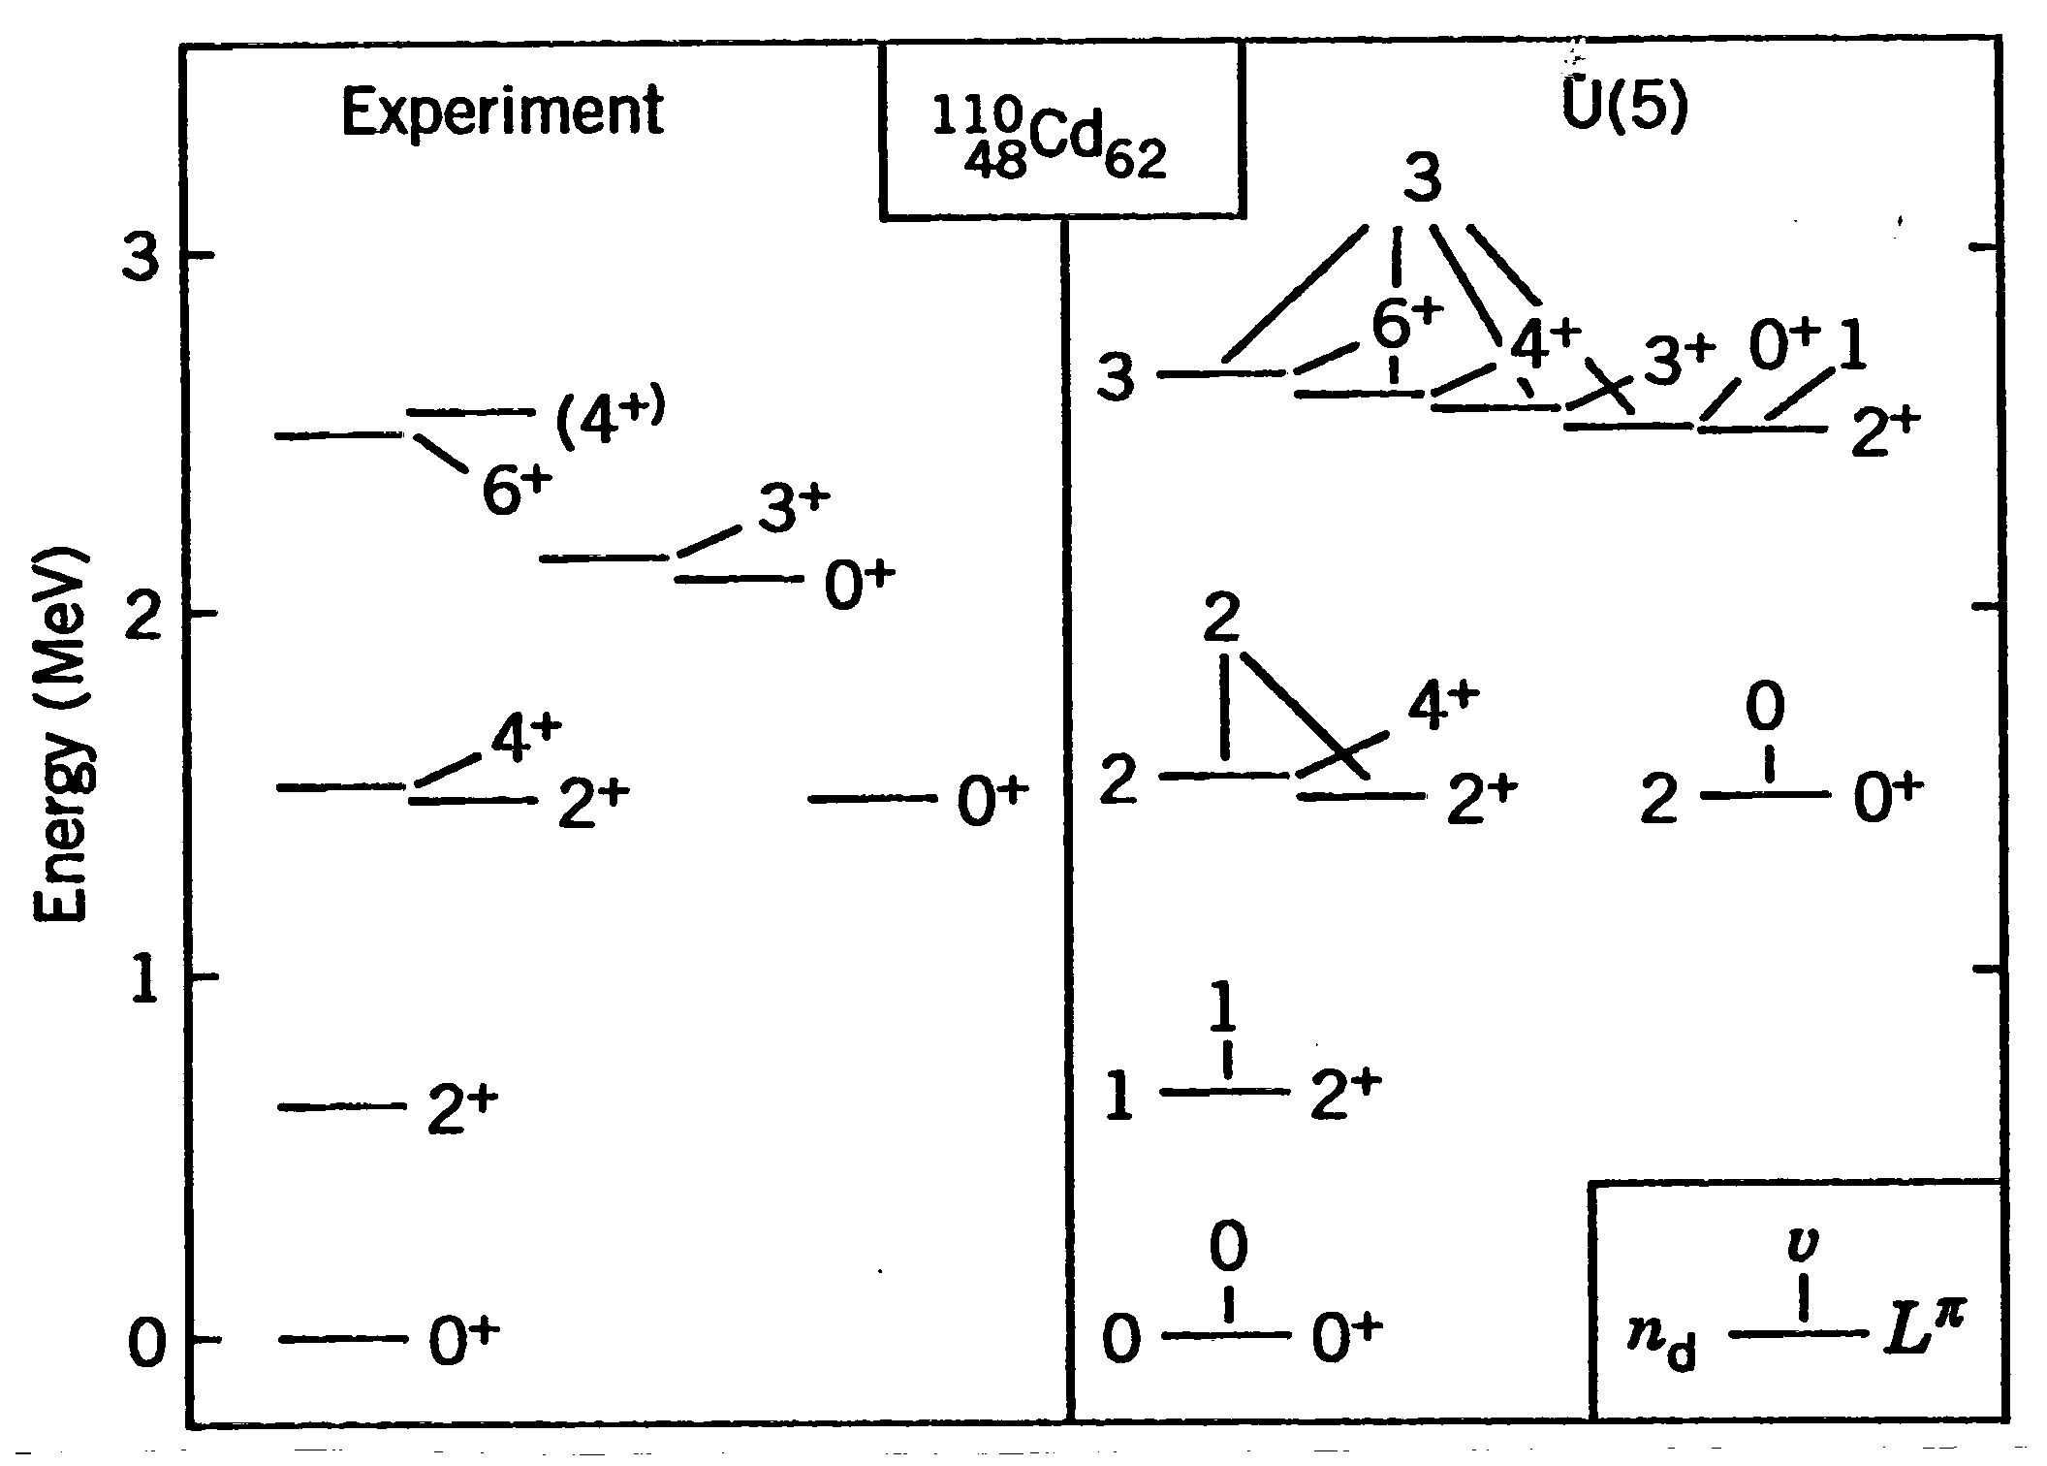
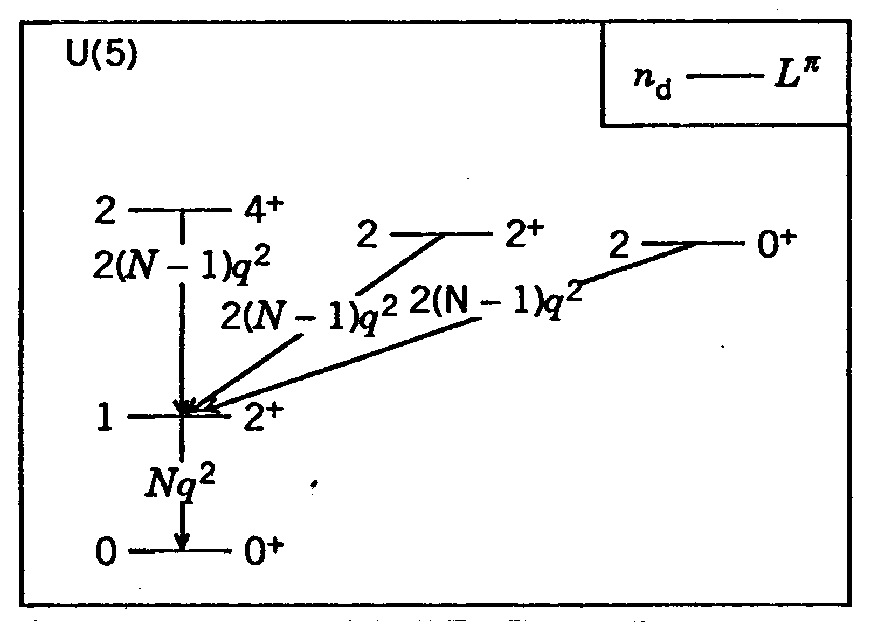
The U(5) vibrational limit
Anharmonic vibration spectrum associated with the quadrupole oscillations of a spherical surface.
Conserved quantum numbers: n_{d}, υ, L.
A. Arima & F. Iachello, Ann. Phys. (NY) 99 (1976) 253
D. Brink et al., Phys. Lett. 19 (1965) 413

Slide 19
The SU(3) rotational limit
SU(3) Hamiltonian:
Energy eigenvalues:

Slide 20
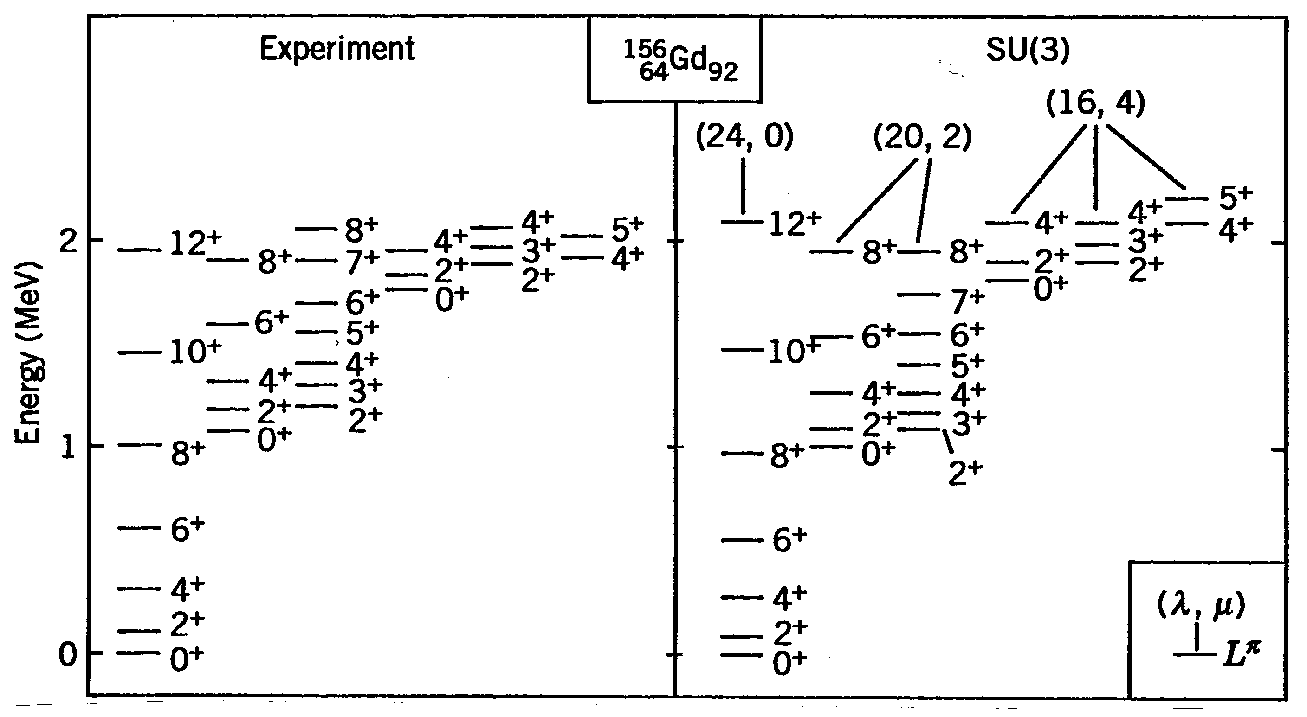
The SU(3) rotational limit
Rotation-vibration spectrum of quadrupole oscillations of a spheroidal surface.
Conserved quantum numbers: (λ,μ), L.
A. Arima & F. Iachello,
Ann. Phys. (NY) 111 (1978) 201
A. Bohr & B.R. Mottelson, Dan. Vid.
Selsk. Mat.-Fys. Medd. 27 (1953) No 16

Slide 21
The features of the SU(3) limit: [Iachello & Arima (1987) and (1978)] A) The energy ratio R₄₂ = 10/3. B) The energy gap between the two neighbouring levels of the ground state rotational band and the β-vibrational band remains consistent. C) The energy levels of states with identical spin values (I) are equivalent for both the γ-vibrational and β-vibrational bands. This means that these γ- and β- bands exhibit degeneracy for the same spin states. D) There exist many bands with different properties: the ground state rotational (g-)band with K^{π} =0₁⁺, the β-vibrational band with K^{π} =0₂⁺, the γ-vibrational band with K^{π} =2₁⁺, the β2-vibrational band with K^{π} =0₃⁺, the βγ-vibrational band with K^{π} =2₂⁺, ⁺, the γγ-vibrational band with K^{π} =4₁⁺, etc. E) The band mixing parameter Z_{γ}, which relates to the B(E2) values between the γ-band and the g-band, has a value of zero. F) The ratio of B(E2; 0_{β}⁺→2_{g}⁺) / B (E2; 2_{γ}⁺→0_{g}⁺) = 1/6. G) The ratio of B(E2; 2_{γ}⁺→0_{g}⁺) / B (E2; 2_{g}⁺→0_{g}⁺) = 0.

Slide 22
The SO(6) γ-unstable limit
SO(6) Hamiltonian:
Energy eigenvalues:

Slide 23
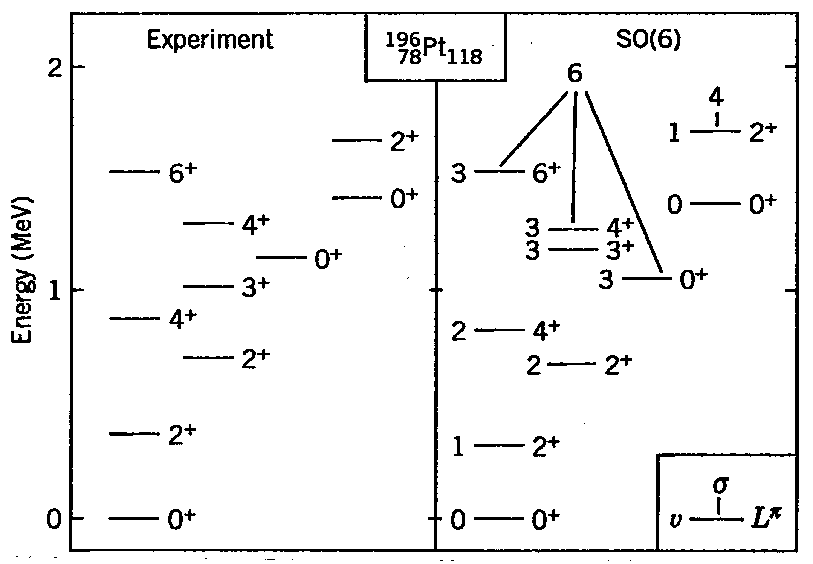
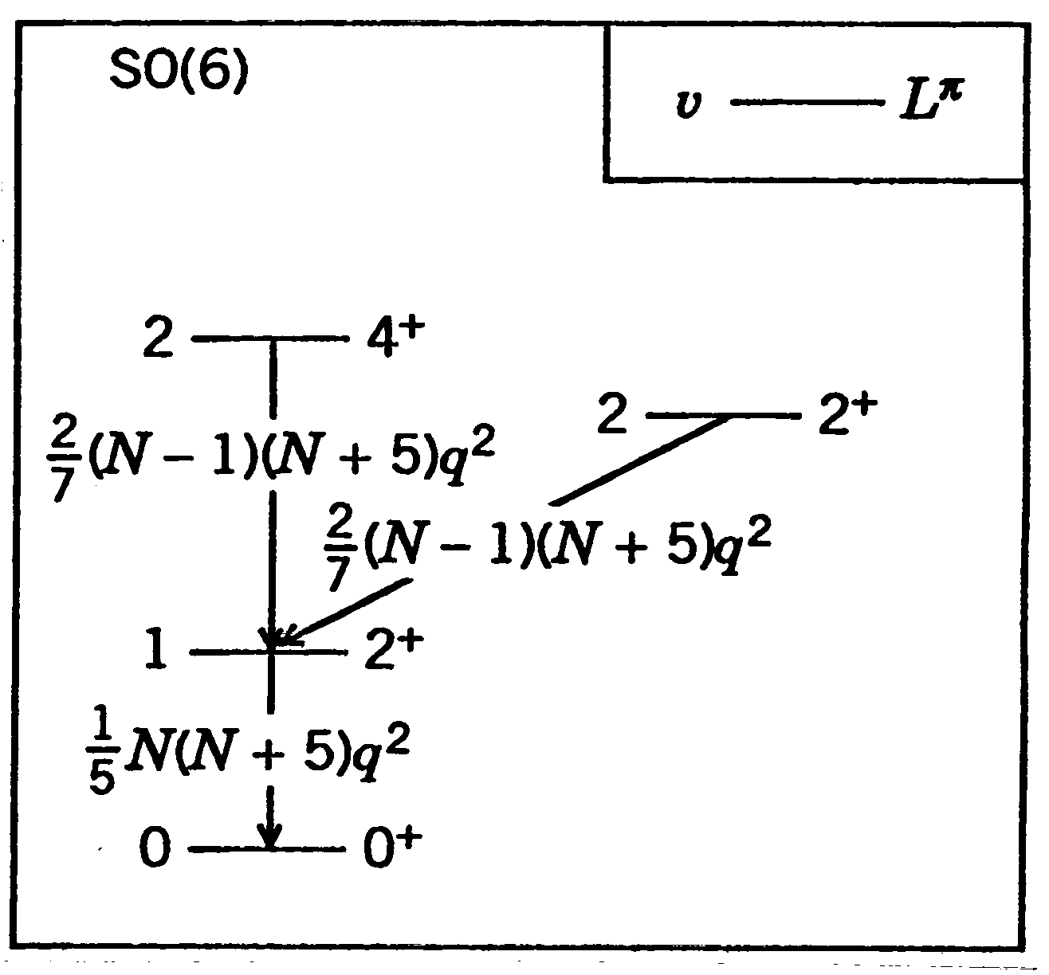
The SO(6) γ-unstable limit
Rotation-vibration spectrum of quadrupole oscillations of a γ-unstable spheroidal surface.
Conserved quantum numbers: σ, υ, L.
A. Arima & F. Iachello, Ann. Phys. (NY) 123 (1979) 468
L. Wilets & M. Jean, Phys. Rev. 102 (1956) 788

Slide 24
In the O(6) limit, the nuclei exhibit the following characteristics: A)The ground state (g-) band is denoted as |N, σ = N, τ, L = 2τ >. B)The γ- band exhibits an energy level pattern that shows staggering, with states like 2γ+, (3γ+, 4γ+), (5γ+, 6γ+), and so on. In contrast, the tri-axial rotor with the asymmetry parameter (γ₀) displays a different staggering pattern, with states like (2γ+, 3γ+), (4γ+, 5γ+), and so on. C)The β- band follows a sequence of 0⁺(τ=3) - 2⁺(τ=4) - 2⁺(τ=5) with significant energy gaps between these states. D)The 0_{β}⁺ state is positioned at a lower energy level than the 3γ+ state. E)The operator E(2), represented by Q₂(χ = 0), follows a selection rule: Δσ = 0, Δτ = ±1. Consequently, the 0_{β}⁺ state tends to decay primarily to the 2₂⁺ state. F) The ¹³⁴Ba and ¹⁹⁶Pt are the most notable instances of nuclei that adhere to the O(6) limiting type characteristics. G)The energy ratio R₄₂ = 2.5. [Iachello & Arima (1987) and (1979)]

Slide 25
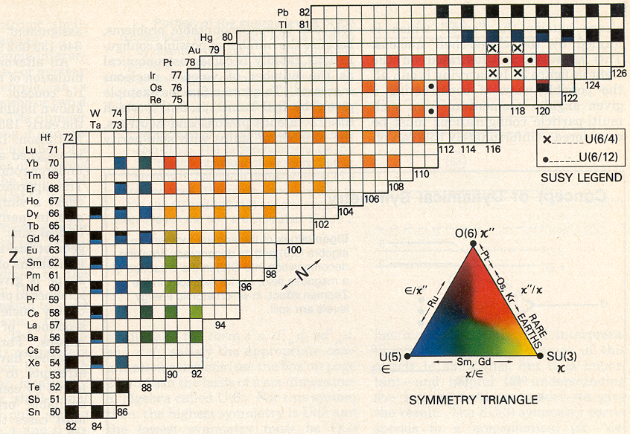
Applications of IBM

Slide 26
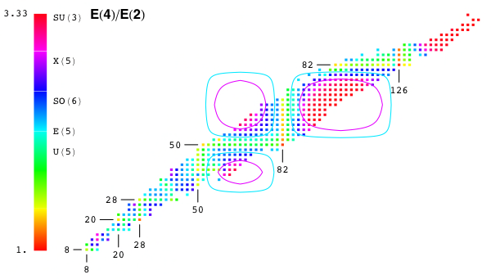
The Ratio R₄₂
In even Z even N nuclei, the energy ratio R₄₂ (=E_{4g}⁺/E_{2g}⁺) is good measure of deformation and it helps in categorizing the atomic nuclei. For vibrational or SU(5), E(5) symmetry, γ-soft nuclei or SO(6), X(5) symmetry and rotational or SU(3) type nuclei the value of R₄ is 2.0, 2.2, 2.5, 2.9 and 3.33, respectively.

Slide 27
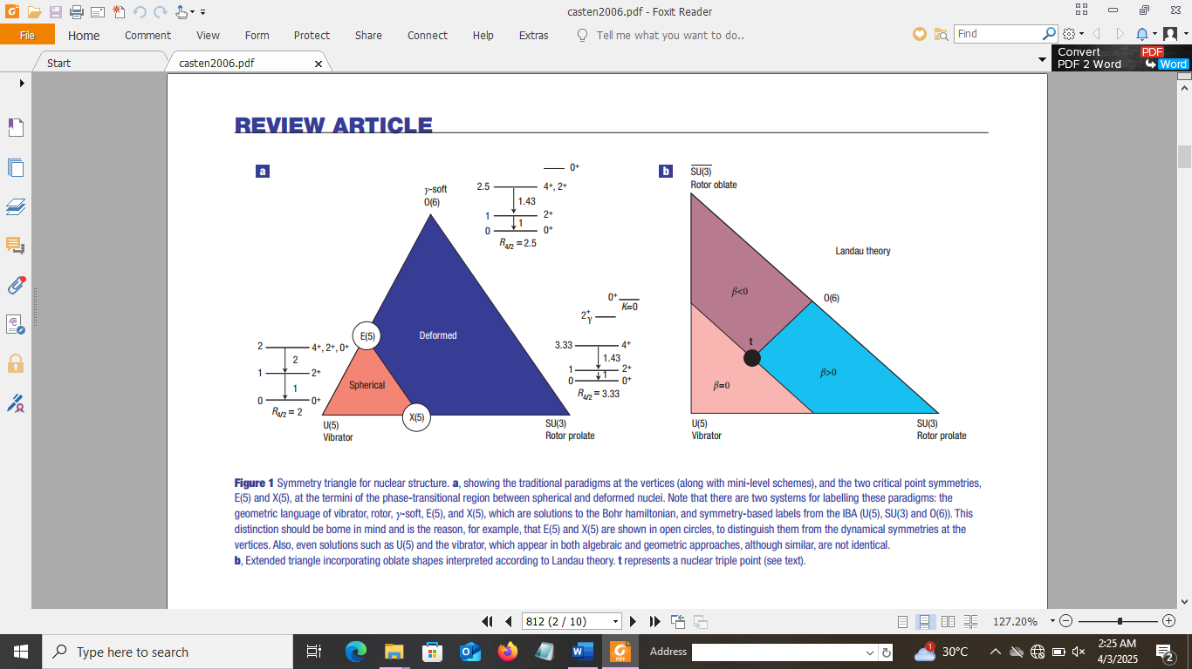
Casten (2006)

Slide 28
SYMMETRY TRIANGLE FOR NUCLEAR STRUCTURE. (a) Showing the traditional paradigms at the vertices (along with mini-level schemes), and the two critical point symmetries, E(5) and X(5), at the termini of the phase-transitional region between spherical and deformed nuclei. Note that there are two systems for labelling these paradigms: the geometric language of vibrator, rotor, γ-soft, E(5), and X(5), which are solutions to the Bohr Hamiltonian, and symmetry-based labels from the IBA (U(5), SU(3) and O(6)). This distinction should be borne in mind and is the reason, for example, that E(5) and X(5) are shown in open circles, to distinguish them from the dynamical symmetries at the vertices. Also, even solutions such as U(5) and the vibrator, which appear in both algebraic and geometric approaches, although similar, are not identical. (b) Extended triangle incorporating oblate shapes interpreted according to Landau theory. t represents a nuclear triple point.

Slide 29
The Interacting Boson Model and Calculations The two body effective Hamiltonian for a system of s- and d- bosons can be written as Eq.1:
,
In above Eq. (1), E₀ is the core energy; ɛ’_{s} and ɛ’_{d} are the binding energies of s and d bosons energies; c_{L} , ṽ _{L} and u_{L} describe the two-boson interaction. Another form of Hamiltonian is:
H’= ɛ” n_{d} + a₀ (P†.P) + a₁ (L.L) + a₂(Q.Q) + a₃ (T₃.T₃) + a₄(T₄.T₄) (2)
where,
A least square fitting technique is used to find out the optimized values of the four parameters i.e., ɛ”, a₀, a₁ and a_{2;} while a₃ = a₄ =0, for a nucleus lies on SU(5) to SU(3) transition in Eq. (2). The PHINT programme (Scholten, 1979a) is used to fit the observed energy spectra of a nucleus. All levels with reliable spin assignment (I^{л} < 10⁺) are to be included up to the point that the first level with an uncertain spin assignment appears. In fitting of the energy spectra, we first determine the four parameters of H’ as discussed above, that reproduce the best lower and higher bands.

Slide 30
The optimized values of these four boson- boson interaction parameters with E2SD (= α₂) and E2DD (= √5β₂) are the input for the FBEM programme (Scholten, 1979b). The E2 transition operator depends upon two parameters α₂ and β₂ as given below: T(E2) = α₂ [d† + s† ]⁽²⁾ + β₂[d† ]⁽²⁾ where, α₂ is called the boson effective charge, simply the scaling parameter and affecting the B(E2) values and β₂ accounts for nuclear shape transition. The ratio E2DD/ E2SD =2.958 in the SU(3) limit and reduced to zero in the O(6) limit. The FBEM program (Scholten, 1979b) gives the B(E2) values and ratios. ------------------------------------------- A. Arima and F. Iachello , Advances in Nuclear Physics, edited by J. W. Negela and E. Vogts (Plenum Press, New York), Vol. 13, 1984. F. Iachello and A. Arima, The Interacting Boson Model (Cambridge University Press, Cambridge), 1987. R. F. Casten, Nuclear Structure from a Simple Perspective, (Oxford University Press, New York) 1990. O. Scholten, Programme PHINT, KVI internal report 63 (1979a). O. Scholten, Programme FBEM, KVI internal report 63 (1979b).

Slide 31
Old References:

Slide 32
New References:
6 | B (E2; 01 →21), Isomer shifts δ<r2> = <r2>21 - <r2>01 | ¹⁴⁸⁻¹⁵⁴Sm ¹⁵²⁻¹⁶⁰Gd | Mesoscopic Systems, IBM | Iachello and Zamfir | PRL 92(21) (2004) 212501-1
7 | E (g-, β-, γ- bands) B(E2) values, Q | ¹⁰⁰Mo | IBM-1 | Ghafoor and Shawn | JUBPAS 31(2) (2023) 176
8 | E (g-, β-, γ- bands) B(E2) values, Q | ¹⁶⁴⁻¹⁸⁴Os | IBM-1 | Gupta- Katoch- Sharma | NPA 1041 (2024) 122765
9 | E (g-, β-, γ- bands) B(E2) values, Q | W (N=86–118) | IBM-1 | Gupta- Katoch- | NPA 1057 (2025) 123032

Slide 33
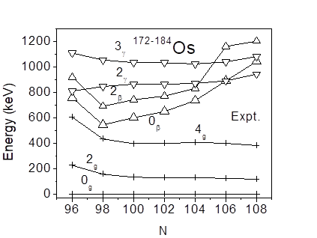
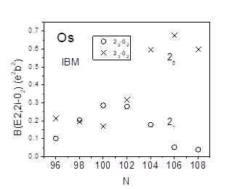
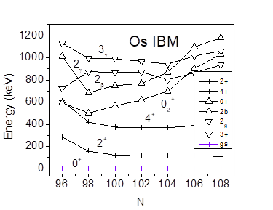
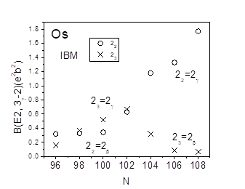
Partial Energy level spectrum of N = 96-108Os in EXPT and IBM-1. [Gupta- Katoch -Sharma, NPA 1041 (2024) 122765]
The B(E2) Values in IBM

Slide 34
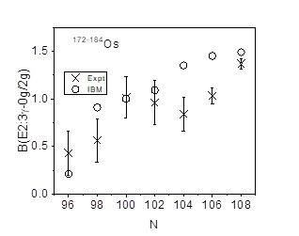
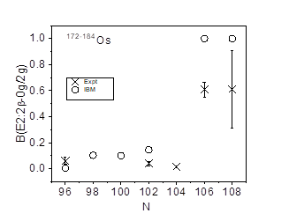
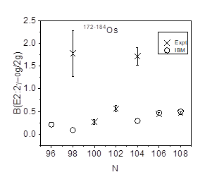
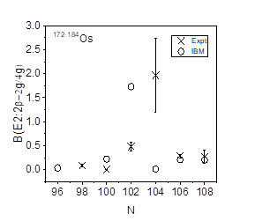
Variation of B(E2) ratios for Os [Gupta- Katoch -Sharma, NPA 1041 (2024) 122765]

Slide 35
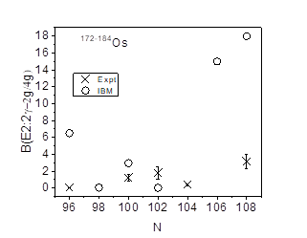
The B(E2; 2γ→2g/4g) vs. N. Fitted parameters (in keV). EPS=Ɛ, QQ=2k, ELL=k’, PAIR=k”/2.
The MULT form of the IBM-1
Hamiltonian consists of 4 terms :
HIBM = Ɛ nd + k Q.Q + k’L.L + k” P.P
In PHINT package, Ɛ = EPS, 2k = QQ, k’ = ELL, k”/2 = PAIR .
The IBM-1 is used to reproduce the β- and γ-bands. The IBM-1 parameters used are given. The inter band B(E2) ratios in IBM-1 are compared with experiment Thus our presentation gives a detailed description of these Os isotopes, and high light their special spectral features. These spectra are similar to those of W and Hf nuclei in quadrant-2. The N=96-108 Os isotopes display the rich structure of ground-, β- and γ- bands. The N=100 ¹⁷⁶Os is X(5) nucleus, beyond which a saturation of deformation is observed. The β- band is low and lies below the γ- band. All these Os isotopes are prolate shaped.
N | EPS | QQ | ELL | PAIR
96 | 479.1 | -16.4 | 1.7 | 2.7
98 | 458 | -19.7 | 8.1 | 8.0
100 | 443 | -20.0 | 11.2 | 8.6
102 | 436 | -18.0 | 14.1 | 10.3
104 | 368 | -16.5 | 20.5 | 10.0
106 | 353 | -18.7 | 27.8 | 20.5
108 | 321.4 | -22.7 | 19.8 | 20.2

Slide 36
Thank you.

